Slide 1


Pre-Game
Presenter (s) Name (s)

Slide 2
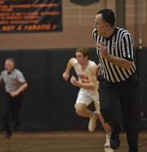

Five Keys to a Successful Pre-Game
Know YOUR primary coverage area and STAY in it
  Own Your Primary
Officiate the defense
  Look for separation
Call the OBVIOUS
Trust your partner(s)
Trail (Two-Person)/ Opposite table (Three-Person) has last shot in almost all situations

Slide 3
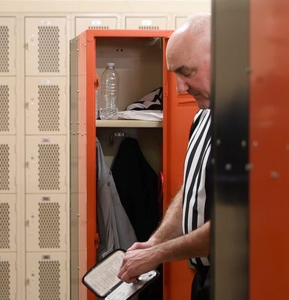
Key Pre-Game Discussion Points
Make sure we start off seeing the same game
Let’s have a GOOD FIRST FOUL of the game. No ticky tack calls!
Be consistent with POST PLAY, HAND CHECKING and BLOCK / CHARGE on both ends of the floor
See what the game and the players bring us in the first 2-3 minutes
Don’t go looking for whistles. Let the plays come to you and your primary
Don’t interrupt FLOW
How to know when we stop TALKING and start BLOWING

Slide 4
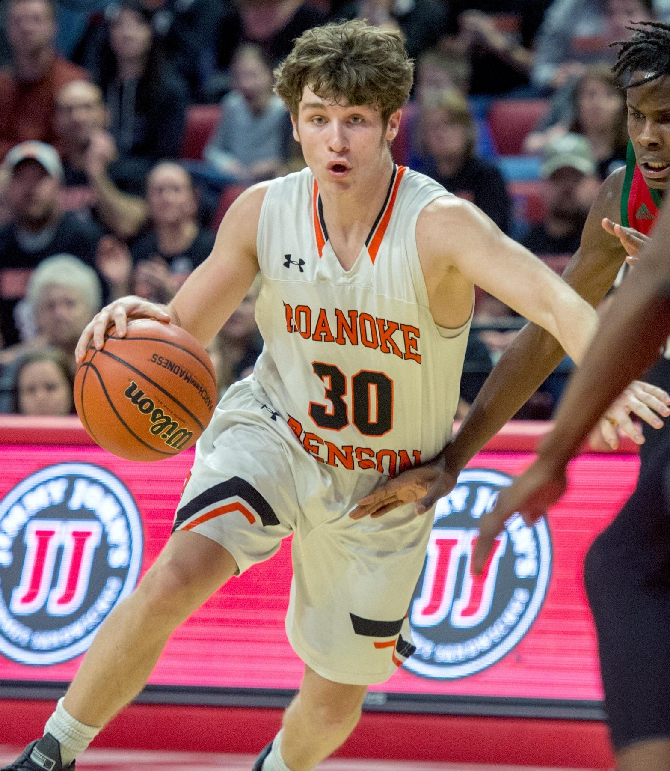
Game Situations to Pre-Game
Dribble / Drives To The Basket…
  Lead, Center & Trail must have “OWN YOUR PRIMARY “ philosophy
  Center & Trail MUST stay engaged longer on dribble / drives
  Come to an agreement on DOUBLE WHISTLES in the paint - POST AND HOLD
  Center & Trail must close down and get angles on rebounds
  EXPECT EVERY SHOT TO BE MISSED

Slide 5
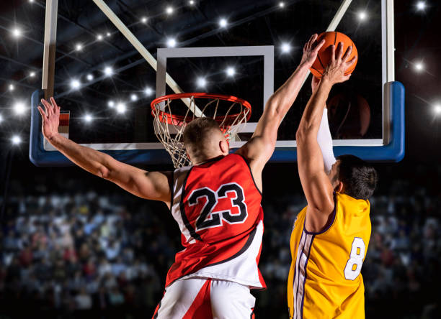
Game Situations to
Pre-Game
Blocked Shot Attempts
  NO PHANTOMS!
  Look for angles & point of contact
  DISPLACEMENT (ADVANTAGE / DISADVANTAGE)
  Assume that every blocked shot attempt is a CLEAN BLOCK until you see point of contact

Slide 6
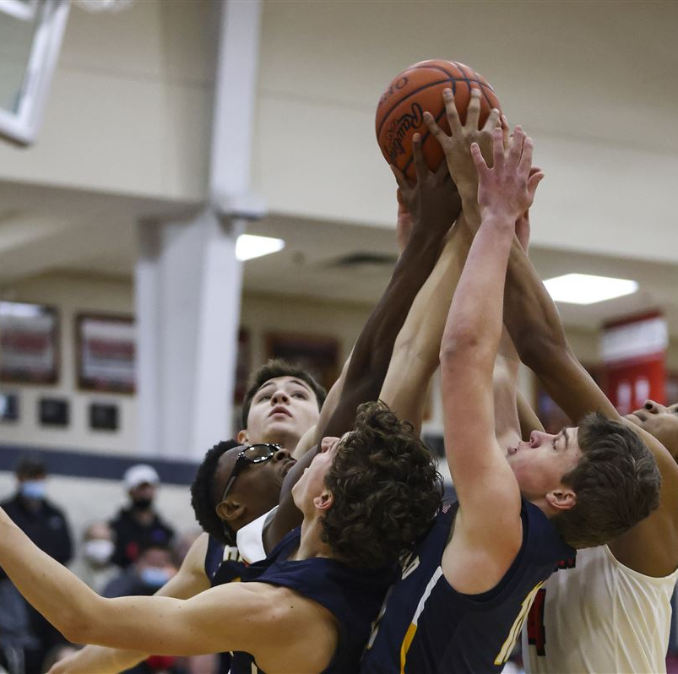
Game Situations to
Pre-Game
Rebounding
  C and T on 90% of rebounding fouls. Lead NO BRAINERS in primary
  C and T MUST close down and NOT BAIL OUT
  Look for verticality and displacement in rebound situations
  Apply advantage / disadvantage to rebound situations

Slide 7
Game Situations to Pre-Game
Fouls
  Communicate the foul with partners AT THE SPOT OF THE FOUL
  Shooter and number of Free Throws
  Communicate with signals and voice to the scorer
  Trail official quarterback the FT administration
Off-Ball Fouls
  Illegal screens, holds, chucks etc. IN YOUR PRIMARY must be called (Game film supported). This will help your game TREMENDOUSLY
  Stay IN YOUR PRIMARY and officiate CONTESTED MATCHUPS

Slide 8
Game Situations to Pre-Game
Perimeter Shooting / Three-Point Line
  Work the 3-point line concept
    60-40 coverage on 3-point attempts
  Watch the shooter back down to the floor to avoid any flops after the attempt. If he / she hits the floor, KNOW how it happened
  Changing a 2-point shot to a 3-point shot is OK
  Changing a 3 to a 2 is NOT OK! (You got caught guessing)

Slide 9
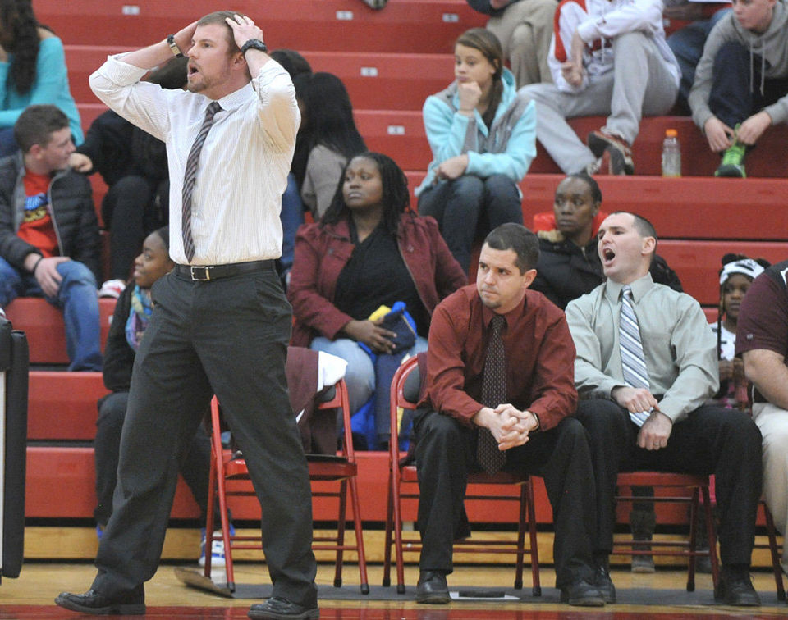
Game Situations to Pre-Game
Bench Communication
  Ask, Warn, Whack (Penalize) philosophy, if at all possible
  Warning IS NOT required
  Stop Sign = Bench Warning
  If you handle it correctly, the COACH calls the PENALTY on themselves

Slide 10
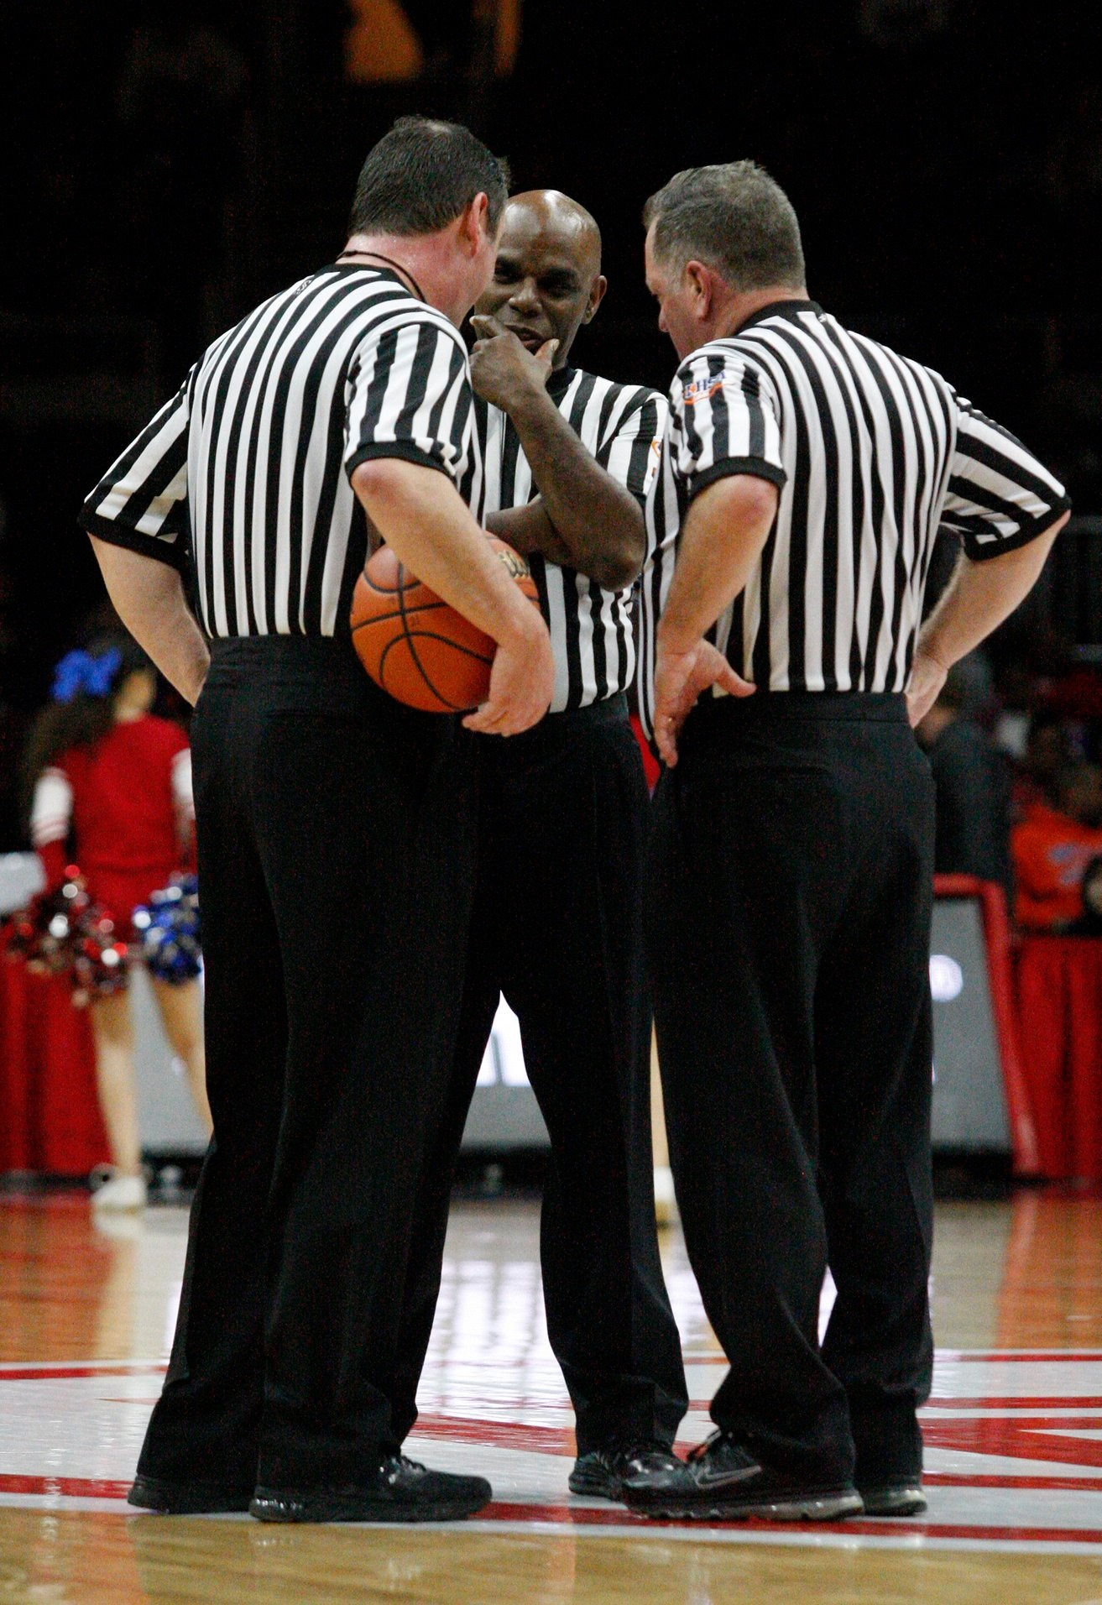
Final Pre-Game Thoughts
Crew Communication
  CAN NEVER BE ENOUGH
  Know how to give and get help
    When asked to help…Signal direction. No discussion. Put ball in play
  Changing a call
    Stay away from EARLY in game, if possible
    Be 150% sure of the change. Official who made the original call will blow the whistle and make the directional change. NO DISCUSSION

Slide 11
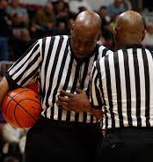
Final Pre-Game Thoughts
Dead Ball Communication During Timeouts
  Know the throw-in spot. Is it designated or can the thrower-in run the endline?
  U1 count 5 players for home team. U2 count 5 players for visitors. R count all 10 before the throw-in (Three-Person)
  R count 5 players for home team. U count 5 players for visitors. Both officials count all 10 before the throw-in (Two-Person)
Trail (2-Person) / Opposite Table (3-Person) has last second shot in almost all cases

Slide 12
Questions / Comments?

