Slide 1


2024-25
Rule Changes
Presenter (s) Name (s)

Slide 2
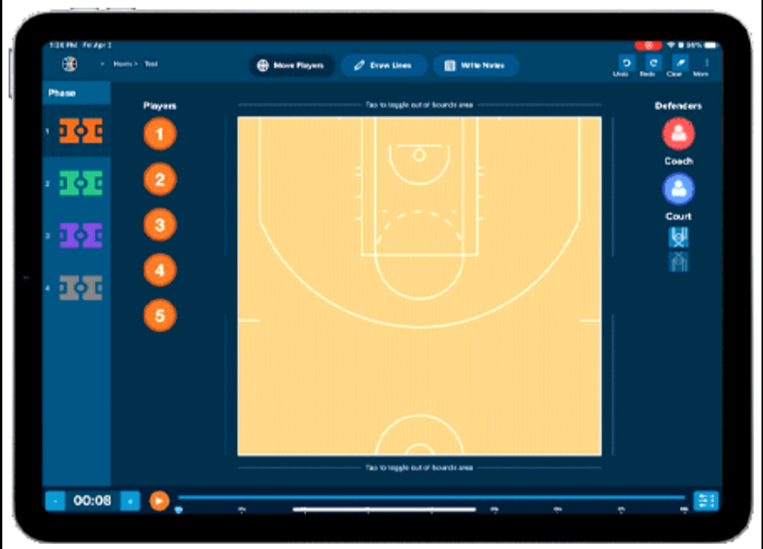

Electronic Devices
1-19: Limits the use of electronic devices used during a game for the purposes of recording and tracking stats, reviewing or diagramming plays, or other similar contest related functions.
Rationale: Clarifies the type of electronic devices that are allowed during the game, prohibiting the use of voice and video recording devices worn during a contest.

Slide 3
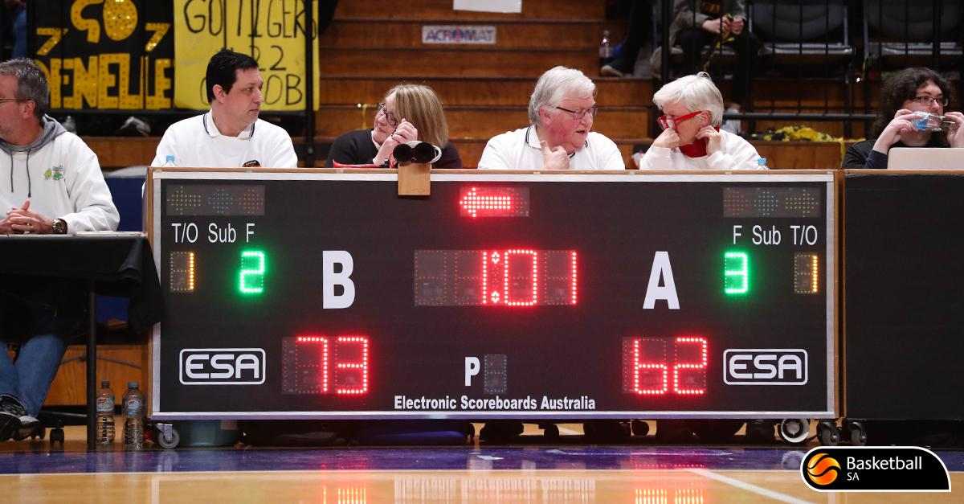
Scorer’s Duties
2-11-11: Requires the non-official scorer(s) to compare records with the official scorer when multiple scorers are present.
Rationale: Allows the official scorer to remain focused on game activity and places the responsibility of comparing scoring and other bookkeeping information on the auxiliary scorer(s).

Slide 4
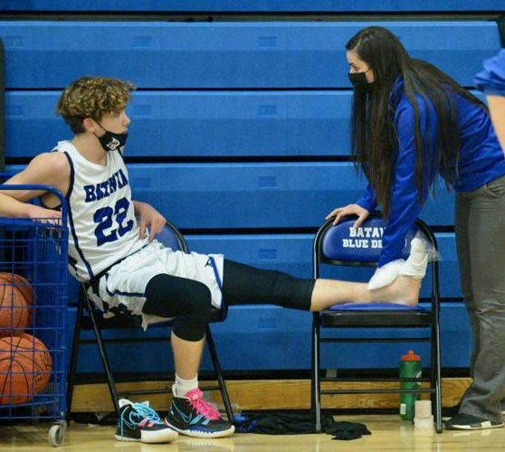
Substitution – Player Removal
3-3-6: Requires a player who has been injured to be removed from the game if the coach is beckoned by the official, whether the coach enters the playing area or not, or if bench personnel (i.e., a coach or athletic trainer) enters the court without being beckoned. The coach may still use a time-out to continue assessment of the injury and keep the injured player in the game.
Rationale: Creates consistency for officials that an injured player is subject to removal from the game when an injury occurs, and the coach/team personnel are beckoned or if they enter the court without an official beckoning.

Slide 5
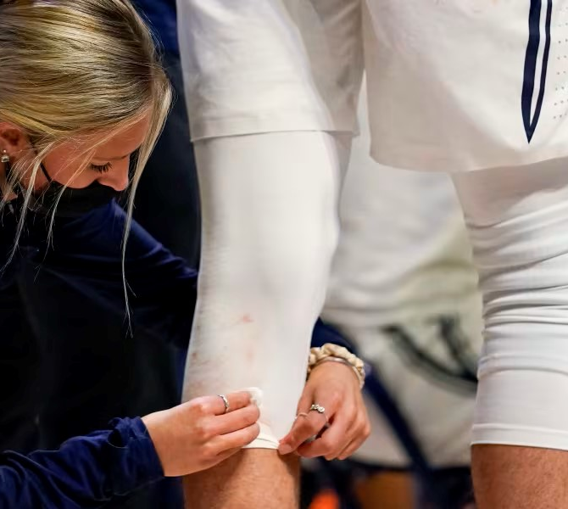
Substitution – 20 seconds
3-3-7: Allows 20 seconds for a player to address any minor blood on the body or uniform without leaving the game. If the blood cannot be appropriately covered/cleaned within 20 seconds, the head coach may take a time-out to address the issue or substitute for the player.
Rationale: Provides a short interval of time to handle a blood related issue without delaying the game, while still addressing the health-related concerns associated with blood on a player.

Slide 6
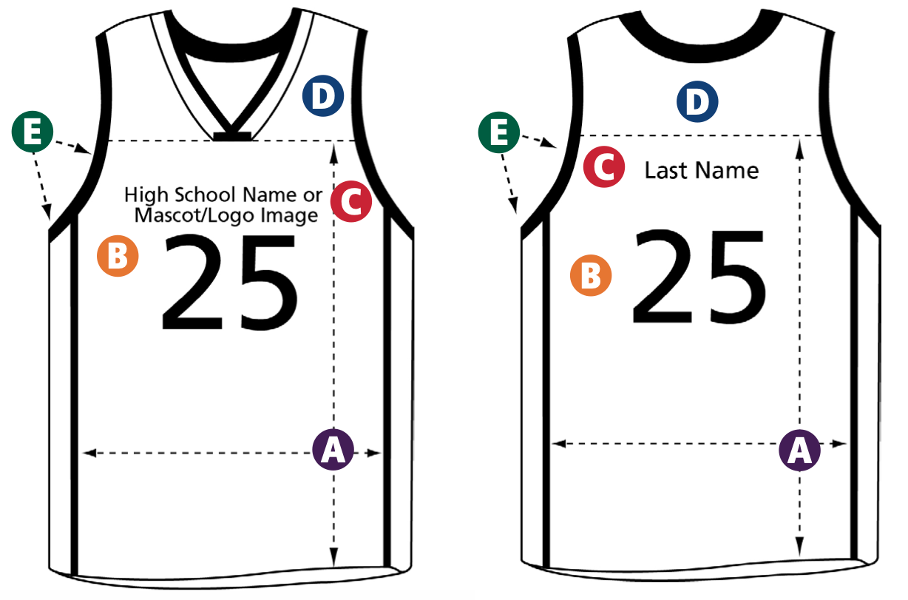
Uniforms
3-4-4a (NEW): Allows the use of a school logo/mascot image to be centered directly above the uniform number in place of an identifying name.
Rationale: Removes the restriction of allowing only lettering on the front of the jersey.

Slide 7
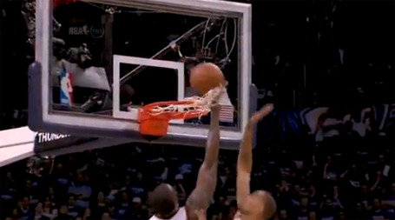
Basket Interference Exception
4-6-1 EXCEPTION (NEW): Creates an exception to basket interference by allowing a player(s) to touch only the net while the ball is on or within the basket provided that the contact did not affect the ball.
Rationale: Allows play to continue unless the contact of the net affects the try for goal.

Slide 8
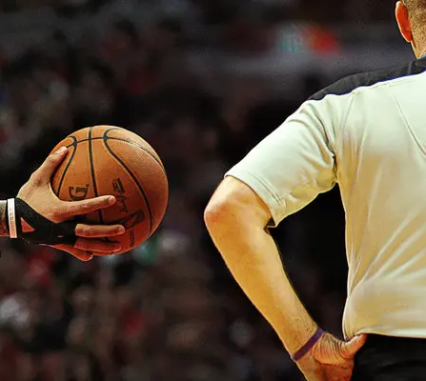
Delay Of Game Warning
4-47-5 (NEW), 10-2-1g (NEW), 10-4-5b: Changes the penalty for failing to immediately pass the ball to the nearer official when a whistle sounds from a player technical to a warning for delay for the first violation and a team technical for any subsequent offense.
Rationale: Allows officials to issue a warning before assessing a technical and the technical will now be assessed to the team and not the player, lessening the severity of the penalty while addressing the behavior.

Slide 9
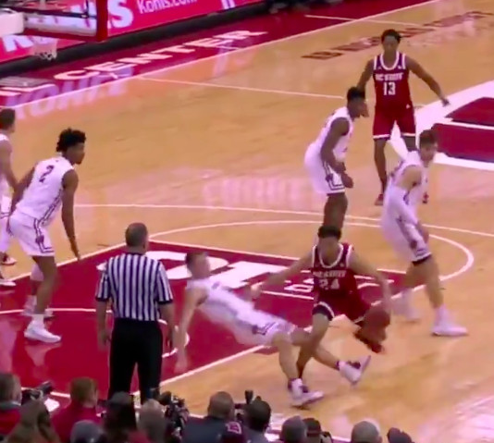
Warning For Faking Being Fouled (Flopping)
4-49 (NEW), 6-4-4g, 10-2-1i (NEW), 10-4-6f: Changes the penalty for faking being fouled from a player technical to a warning for the first violation and a team technical for any subsequent offense and adds a definition and examples.
Rationale: Allows officials to issue a warning before assessing a technical and the technical will now be assessed to the team and not the player, lessening the severity of the penalty while addressing the behavior.

Slide 10
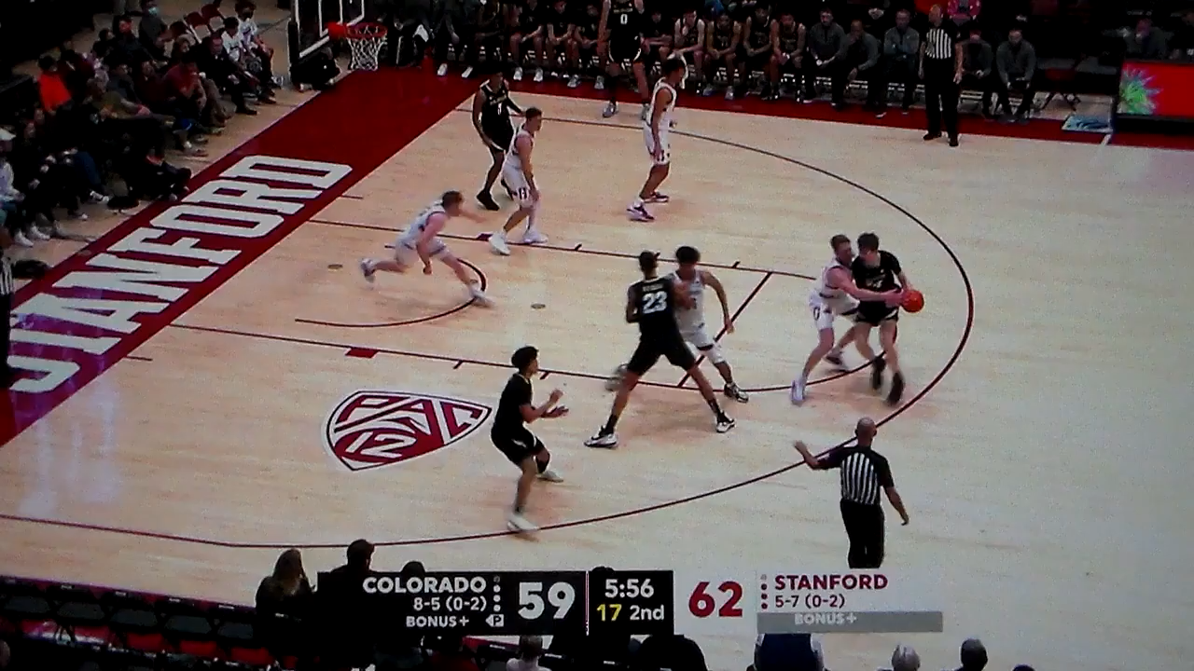
Notes:
Watch the player at the bottom of your screen, #2 black jersey, who makes a three-point attempt. After releasing the shot, with little or no contact, he goes to the floor. The official immediately signals flopping, but waits until the play finishes to blow it dead and assess the technical foul.

Slide 11
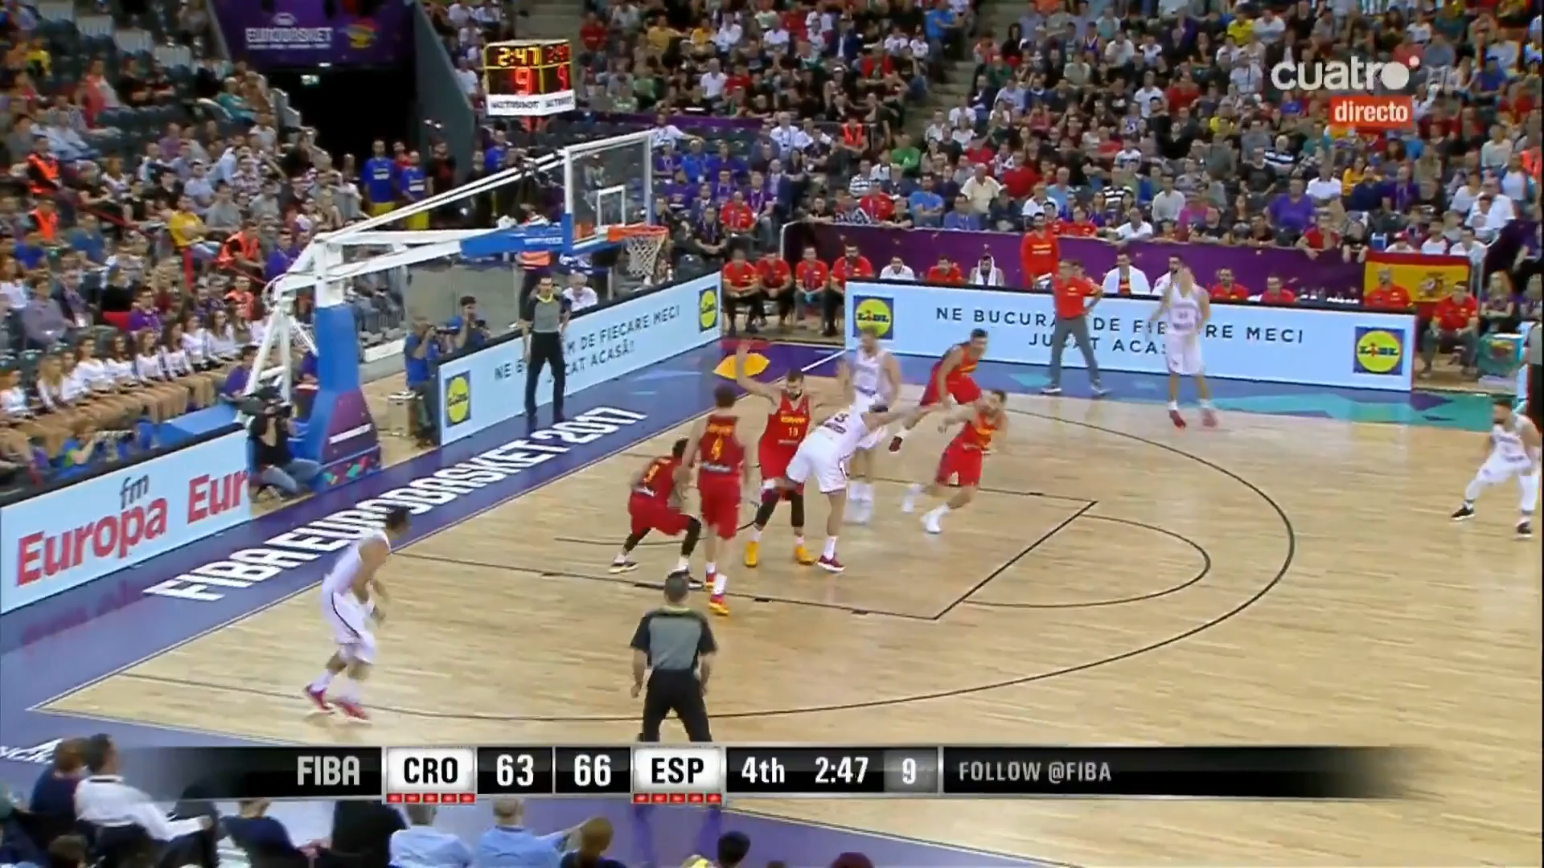
Notes:
On a fast break, drive to the basket, the white defender appears to have established legal guarding position, but had been warned prior in the same game for flopping. Your call on block, charge or flop? Great opportunity to discuss the block or charge call or if a flop call would be warranted even without prior warning.

Slide 12
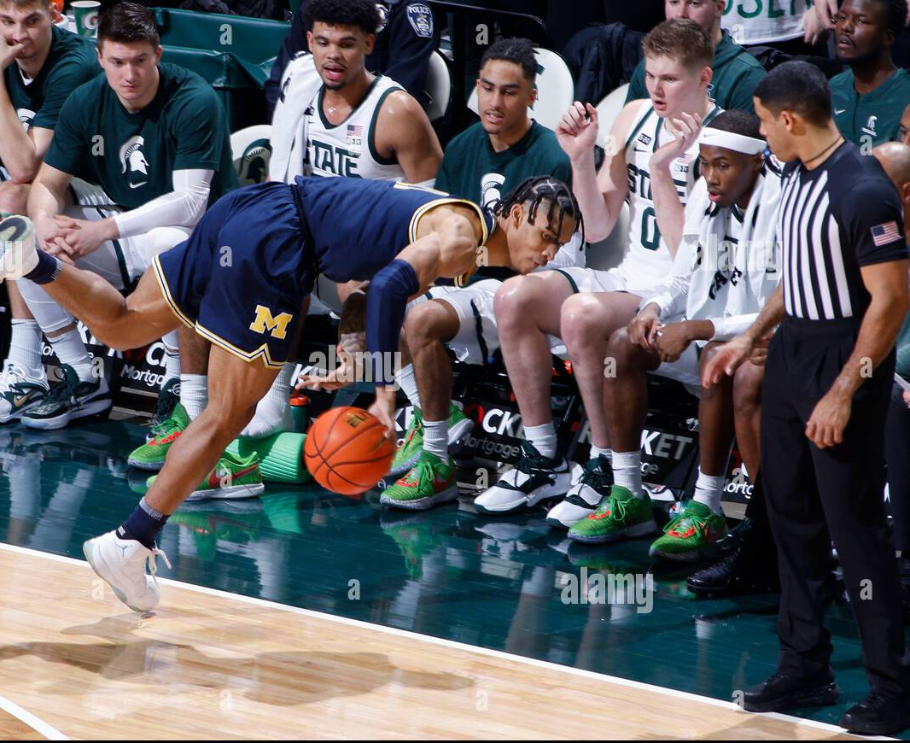
Out Of Bounds – Player, Ball
7-1-1: Establishes that a player is out of bounds if contact by a teammate or other bench personnel outside the boundary line provides an advantage, allowing the player to remain in bounds.
Rationale: Establishes that a player cannot be assisted from outside the boundary line by teammates or bench personnel to remain in-bounds.

Slide 13
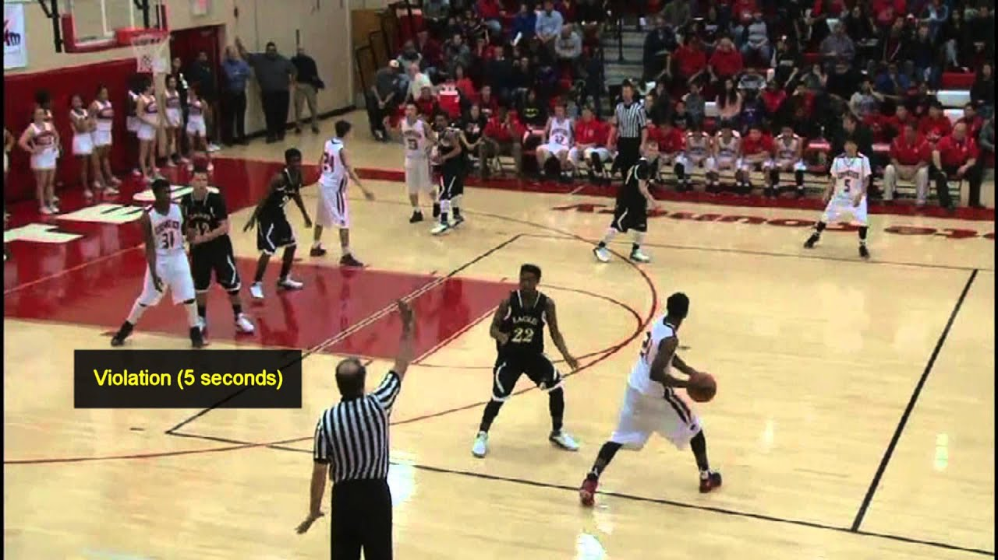
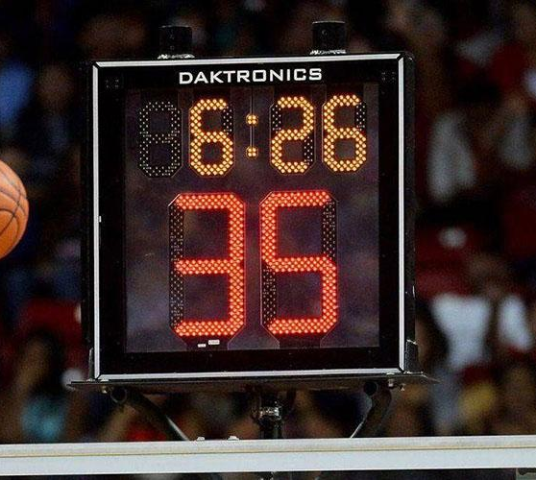
Shot Clock
9-10-1a NOTE (NEW), 4-10: Allows state associations to adopt a modification to the closely guarded rule if they have adopted the 35-second shot clock, allowing players to dribble the ball for more than five seconds while closely guarded and maintain that a player may not hold the ball for five or more seconds.
Rationale: Permits states utilizing the 35-second shot clock to allow players to dribble without enforcing the closely guarded rule since they have a 35-second time limit to attempt a try for goal, maintaining an appropriate pace of play.

Slide 14
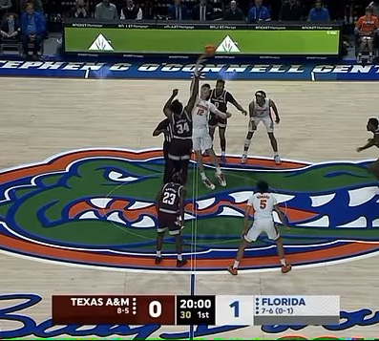
Technical Fouls
10-1-1 PENALTY, 10-1-2 PENALTY, 10-2-7 PENALTY (NEW), 10-5-1 PENALTY(NEW): Establishes that all administrative, team and bench technical fouls that occur during pregame offset – no free throws are awarded – and the game will start with a jump ball and the head coach does not lose the privilege of the coaching box.
Rationale: Clarifies that an equal number of technical fouls committed by both teams during pregame offset and establishes how the game will start after offsetting technical fouls.

Slide 15
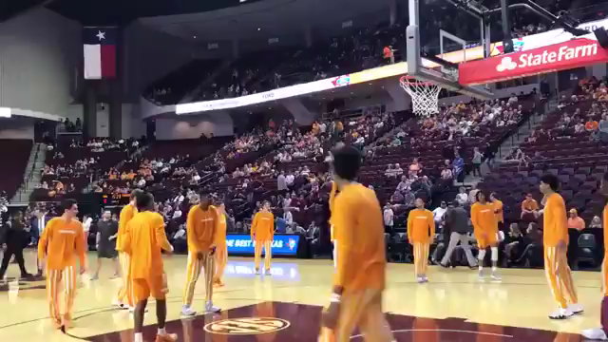
Technical Fouls
10-2-7 (NEW), 10-5-1i: Changes the penalty for dunking or attempting to dunk or stuff a dead ball from a bench technical to a team technical.
Rationale: Continues to penalize the offending team with a team technical foul (free-throws, offended team the ball to start the period, a foul added to the team count), but no longer requires the coach to lose the coaching box to start the game and no personal foul is awarded.

Slide 16
Questions / Comments?

